Slide 1

Consumer recommender and management alert duo
Team members (CodeMavericks)
1-Kishan
2-Amar

Slide 2
Idea
We are building a recommendation system for consumers and an alert system for the product management team.
Main problem we are solving
Embracing Walmart’s motto: ”Save Money. Live Better”
1-We are solving “Customers Problem” of finding quality goods at wallet friendly price.
2-We are solving “Developers Problem” of spotlighting right pick for customer.
3-We are solving “Product management teams problem” for Nailing down the essential while minimizing excess stock.

Slide 3
How are we trying solve this problem?
Dynamic Data Harvesting: Gather live product info, prices, and stock statuses from giants like Amazon, Target, eBay, and more.
Change Tracking Mastery: Monitor shifts and spikes in prices and availability like a hawk.
Instant Insight Alerts: Zap our development team when real-time data dance offers a sweet deal - nudge them to suggest budget-friendly picks.
Proactive Profits with AI: Train our tech with ample data. Predict shortages or price hikes on the horizon, empowering our Product Wizards to seize the advantage.

Slide 4
Demo-: Link the description
Input Sample data
Output Sample Data
Future objectives
Code

Slide 5
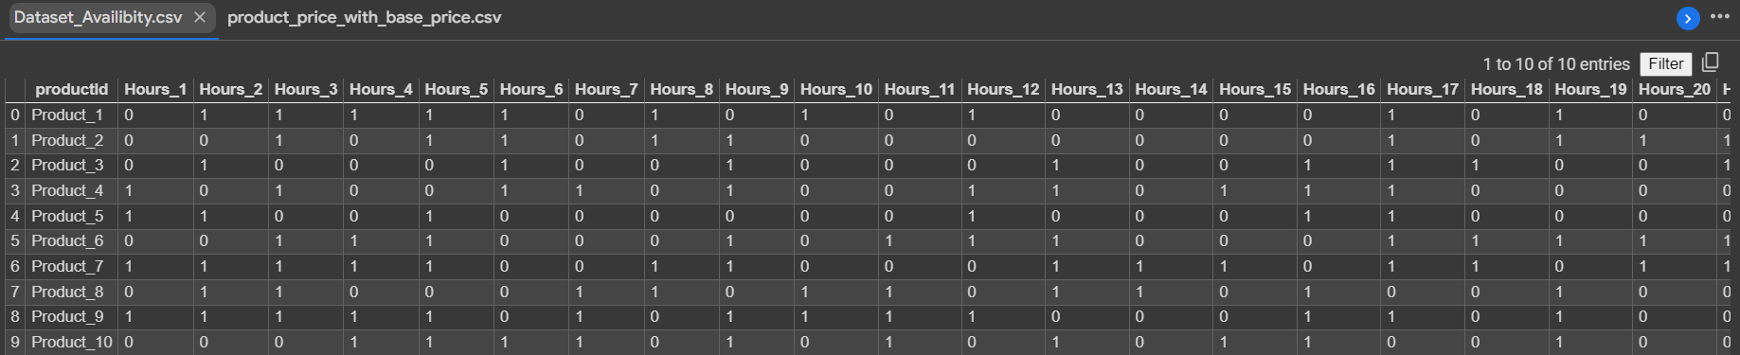
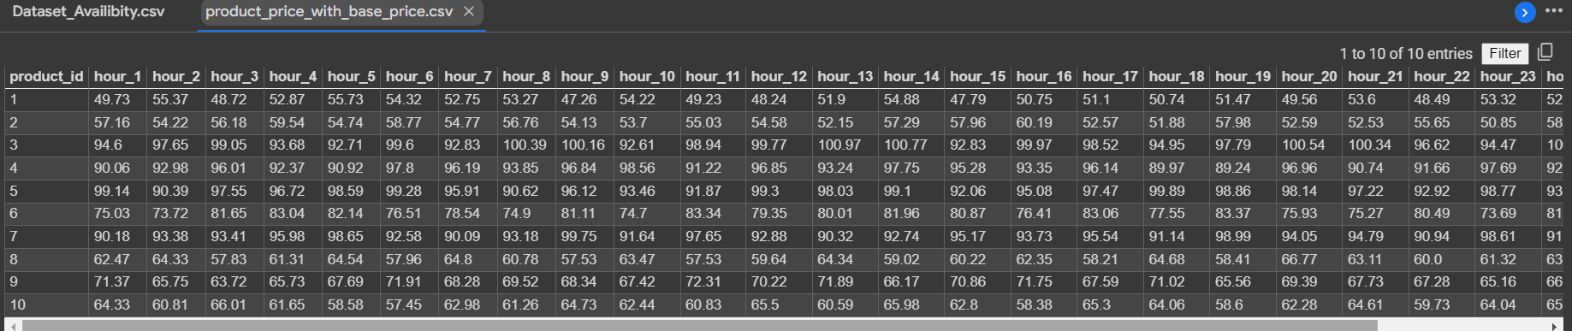
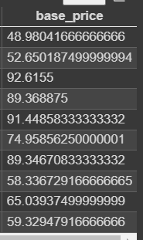
Dataset
Dataset showing availability of the product in other websites every hour of the day
Dataset showing the price of the product in other website each hour of the day, with a attribute called “base_price” which is the minimum cost of selling for the product on our website.

Slide 6
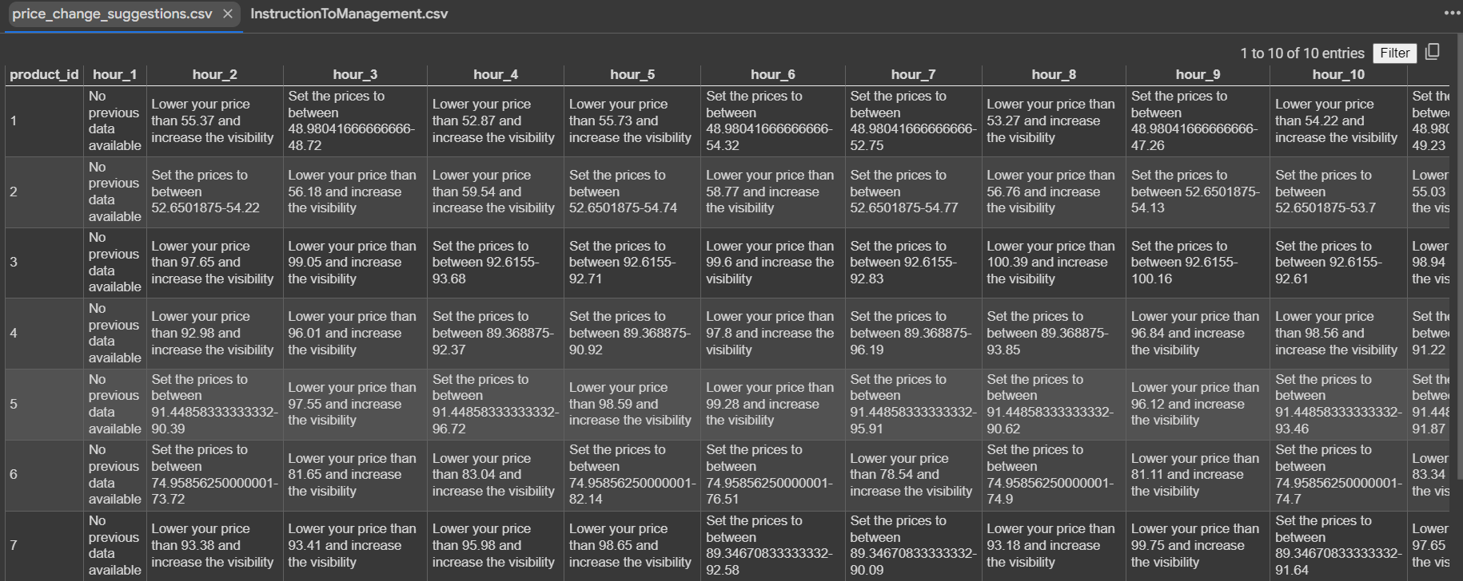
Alert messages overview(1)
Each hour the product team will get an alert about what should be the price of product for this hour so further action can be taken

Slide 7
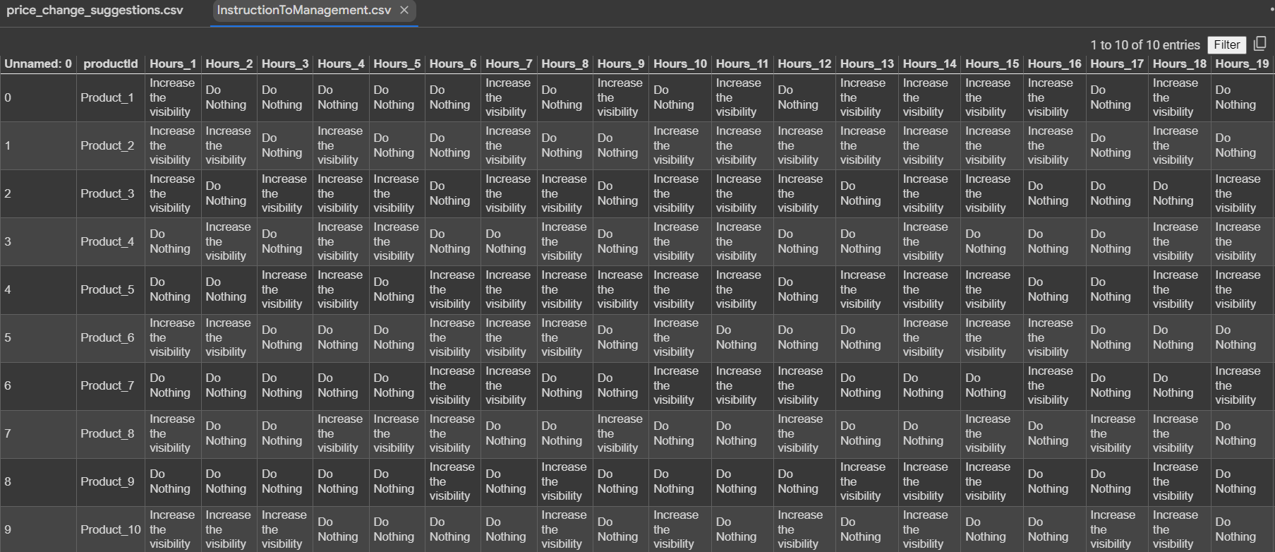
Alert messages overview(2)
Each hour the Development team will get an alert about what product’s visibility should be increased for this hour.

Slide 8
Future Objectives.
Building a machine learning model to predict the availability and prices of products.
Optimising the model.
Suggesting accurate item price for max benefit rather than just alerting.
Collecting Realtime data of product and their availability and prices.

